Slide 1
DATA 606 Capstone Project: The influence of travel restrictions on COVID-19
Hugues Nelson Iradukunda

Slide 2
Motivation & Introduction
Since March 2020, COVID-19 was declared as a global pandemic
As of today, the COVID-19 infections are over 400 millions cases, and the death cases approaches near 8 millions worldwide.
Travel restrictions were imposed to minimize the coronavirus disease infections and deaths.
My goal is to make an analysis of the influence of travel restrictions on COVID-19

Slide 3
Data Sources
COVID-19 Global Travel Restrictions and Airline Information:
COVID-19 travel restrictions by country latest
World Health Organization (WHO) COVID-19 Dashboard:
Latest reported counts of cases and deaths
Vaccination data

Slide 4
Research questions or Hypotheses
Have travel restrictions been effective in preventing COVID-19?
Have vaccinations among the travelers played a significant roles in reducing the virus transmission?
Has travel bans for some countries influenced significantly COVID-19 infections and deaths?

Slide 5
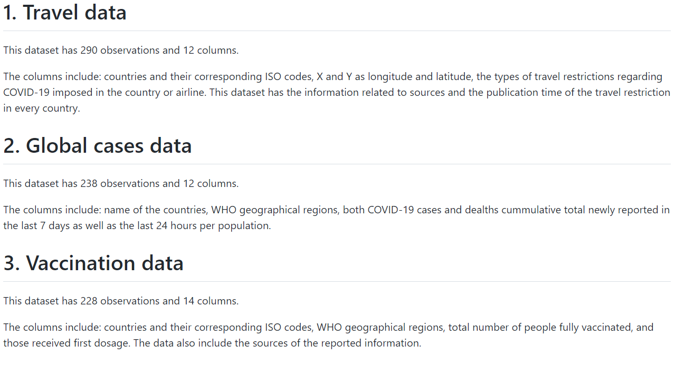
Initial EDA results
Understanding the data sets:

Slide 6
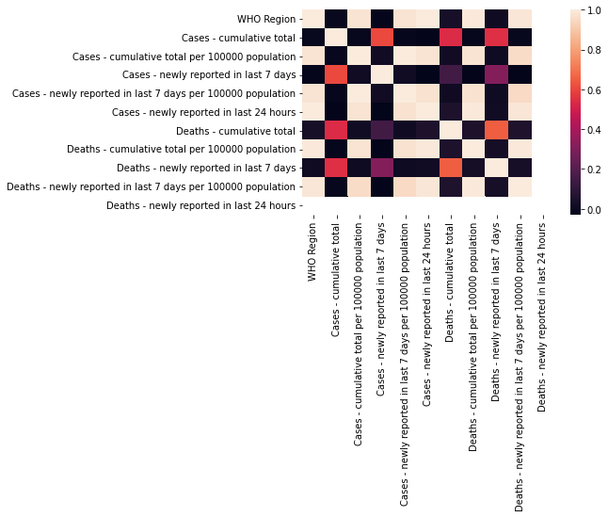
Heatmap for correlations (Global cases)

Slide 7
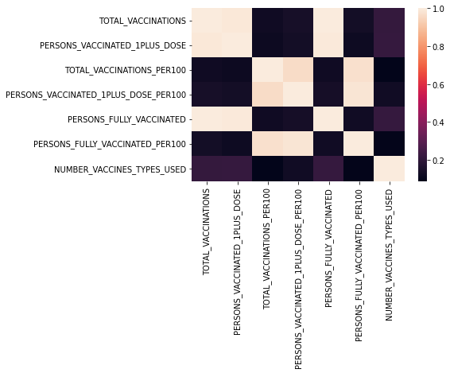
Heatmap for correlation (Vaccination)

Slide 8
ML model (In the next step)
No model has been developed so far.
However, I intend to use unsupervised classification model such as clustering
Clustering will allow me to group similar data points from travel restrictions and assigning them into clusters

Slide 9
Expected outcomes
The effectiveness of the travel restrictions on COVID-19.
The impact of each of several types of travel restrictions in minimizing the number of COVID-19 cases and deaths

Slide 10
References
https://data.humdata.org/dataset/covid-19-global-travel-restrictions-and-airline-information
https://covid19.who.int/info

